Slide 1
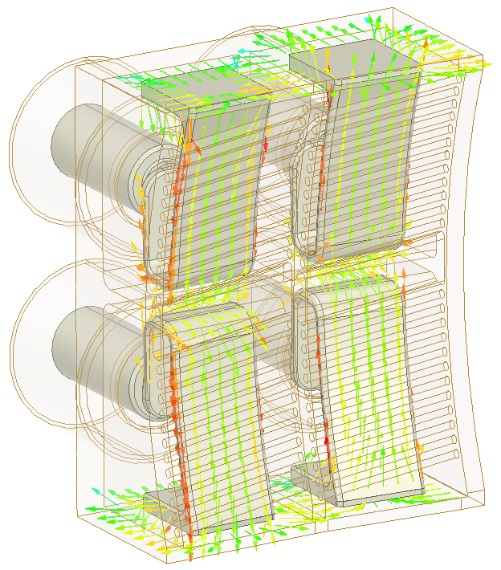

Slide 2
Cut-off surface
Evanescent
layer
Core
plasma
Antenna
Cyclotron
Resonance
Unconfined plasma
Electron density n_{e}
Waves are evanescent
here
Waves are propagative
here
Cut-off
Density n_{c}
Plasma radius R

Slide 3
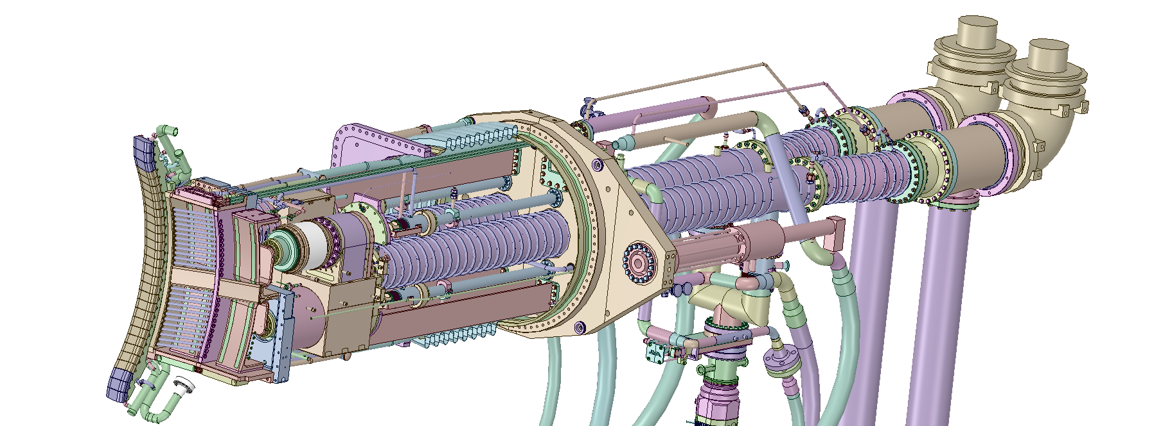

Slide 4
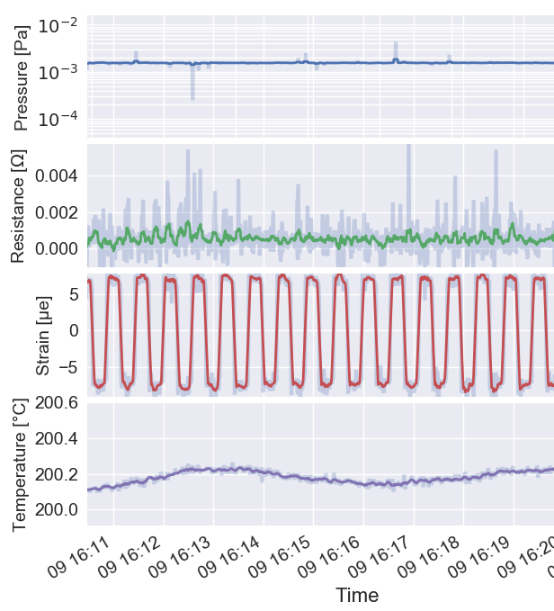

Slide 5
ITER Targets
RF+sliding
2009
1st CW tests
2004
ITER Tests 2012
ITER Tests 2016
JET-ILA
2003
ITER Tests
2012
Trans.Lines
2006
ITER Tests
2012
ITER Tests
2016
Dry air
(IPP)

Slide 6
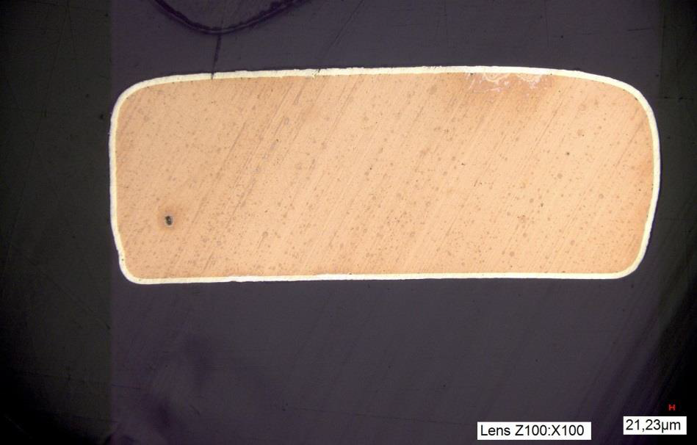
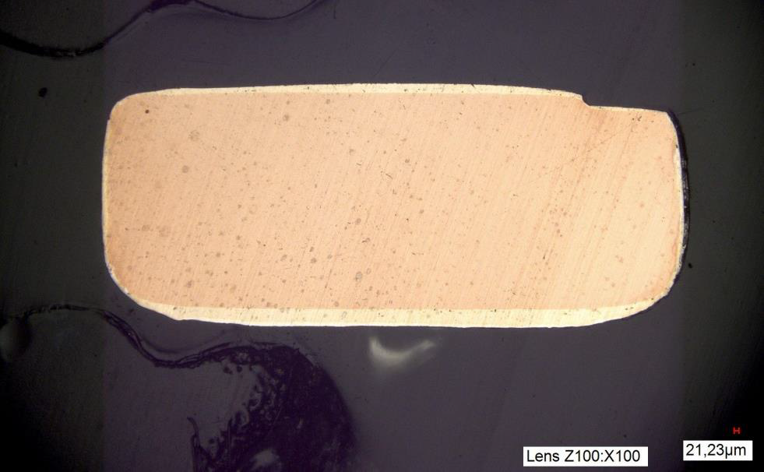
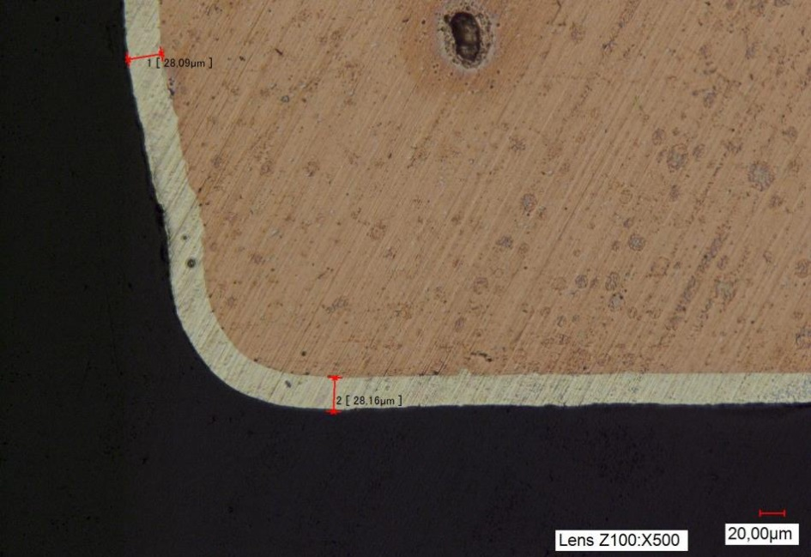
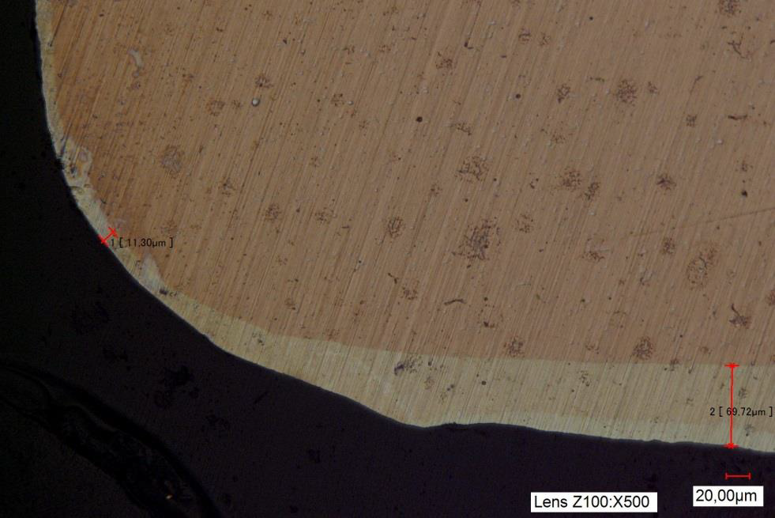
New CuCrZr louver
RF Tested CuCrZr louver
28 µm
11 µm

Slide 7
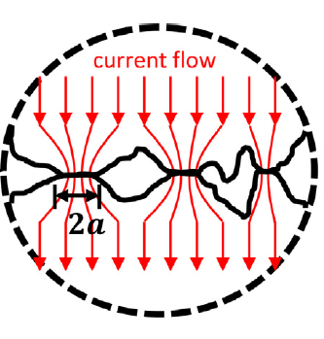
ρ₁
ρ₂
RF conductor A
I
RF conductor B
RF contact louver
R_{C}=(ρ₁ + ρ₂) /4a

Slide 8
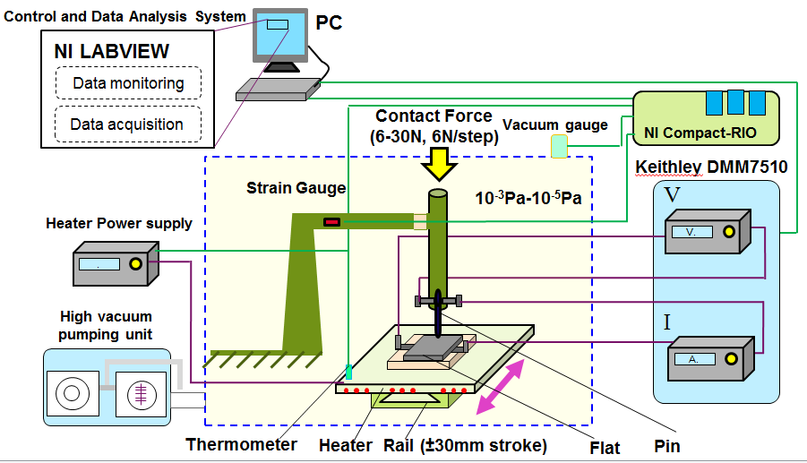
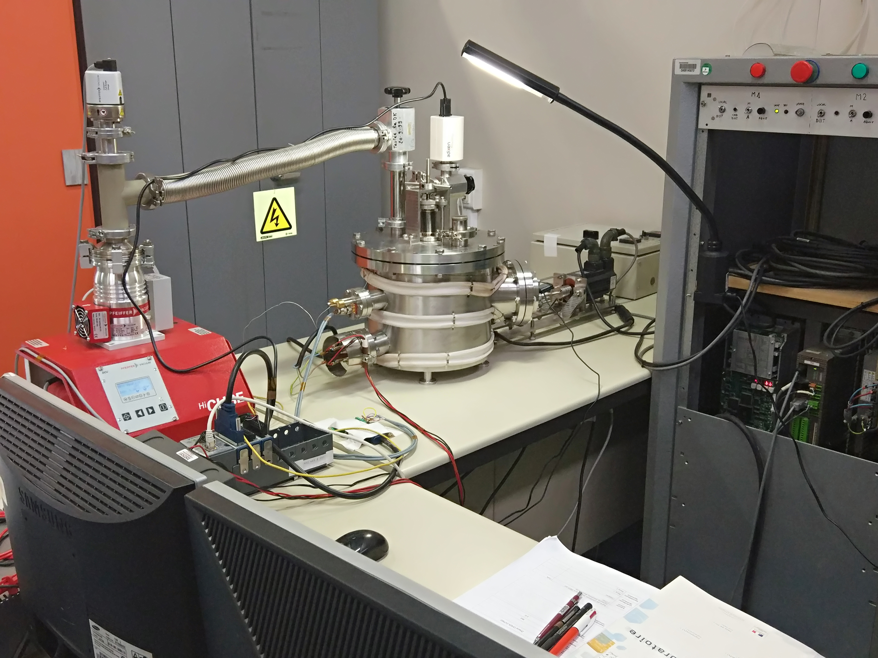

HV-MTEST tribometer
Parameter | value
Contact Force | 6N-30N
Sliding speed | 0-10mm/s
Stroke | ±20mm (Max)
Operating temperature | ≤250ºC (steady-state) 250 ºC -350 ºC short period
Vacuum | 1atm-10⁻⁵Pa
HV-MTEST:
ITER RF contact relevant working conditions are mimicked.
Normal contact force can be adjusted gradually in vacuum.
CoF& Rc simultaneous measurement.

Slide 9
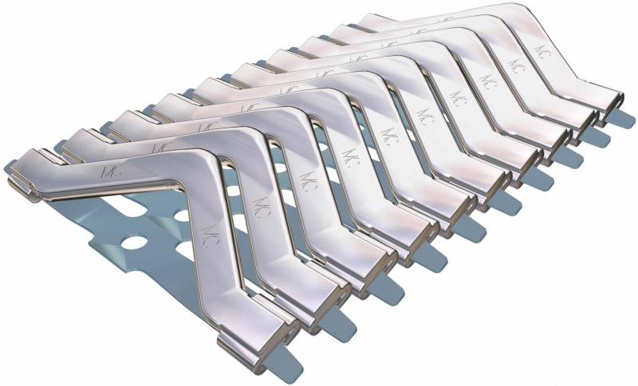
Inner Conductor
Outer Conductor
RF Contacts

Slide 10
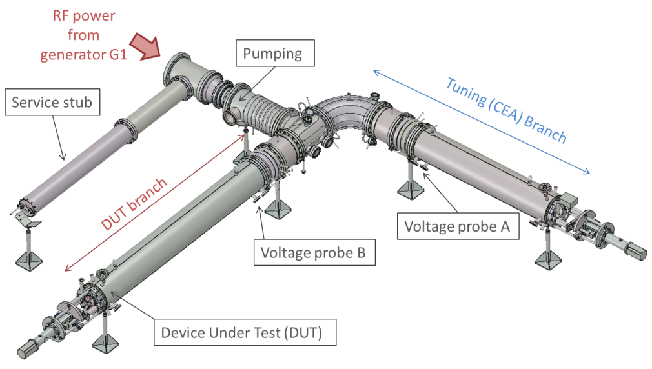
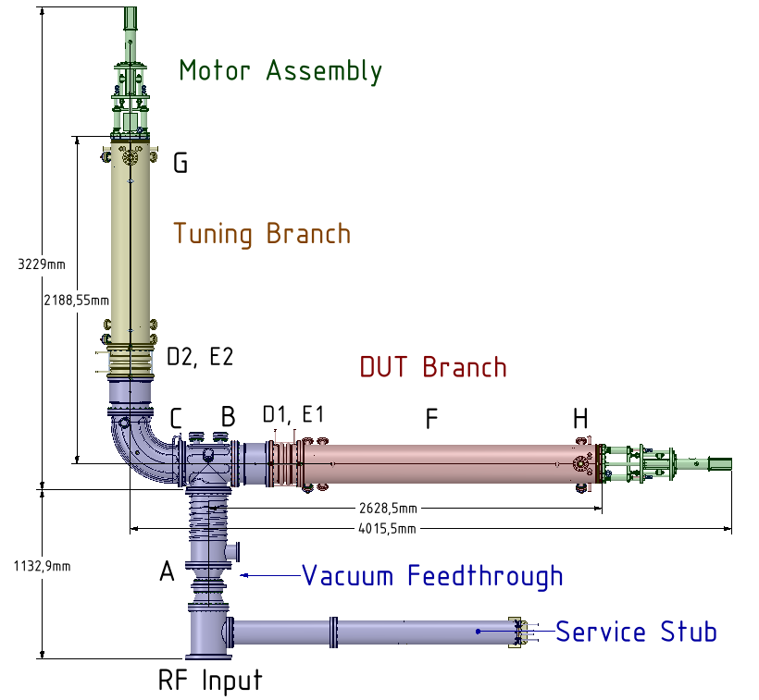

Slide 11
Fix Part
louver
RF Current
Moving Part
Creeping
Bulk material #2
Functional coating #2
Functional coating #1
Bulk material #1

Slide 12
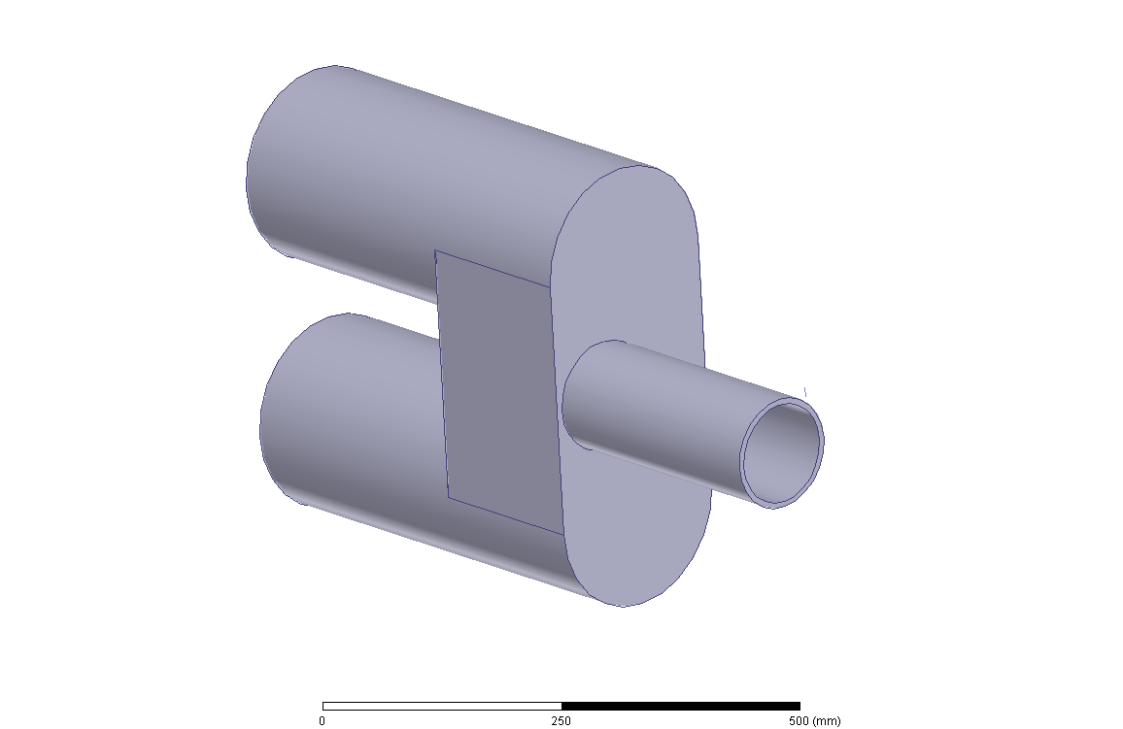
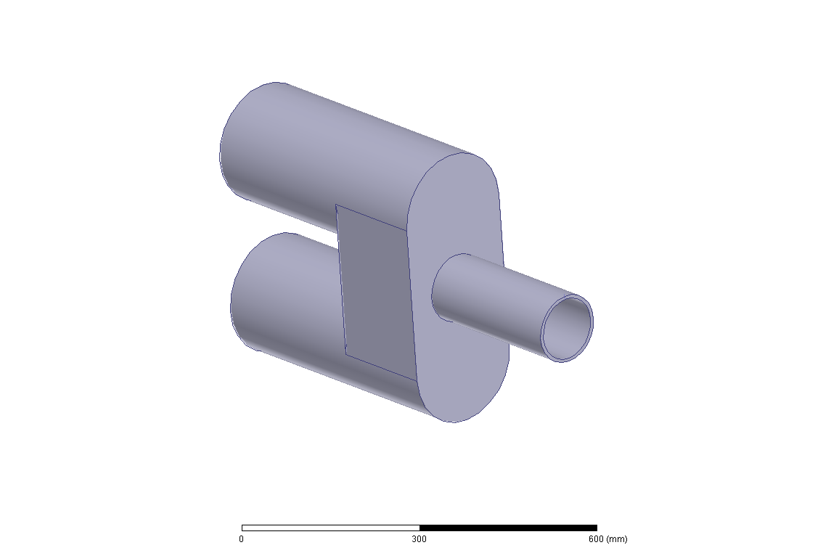

Slide 13
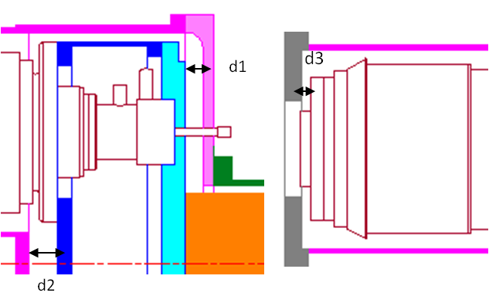

Slide 14
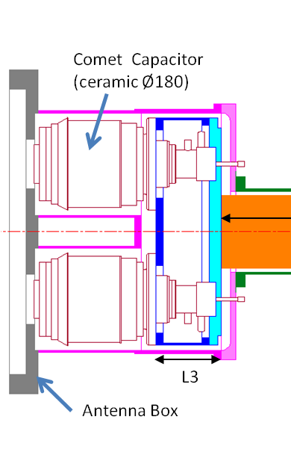

Slide 16
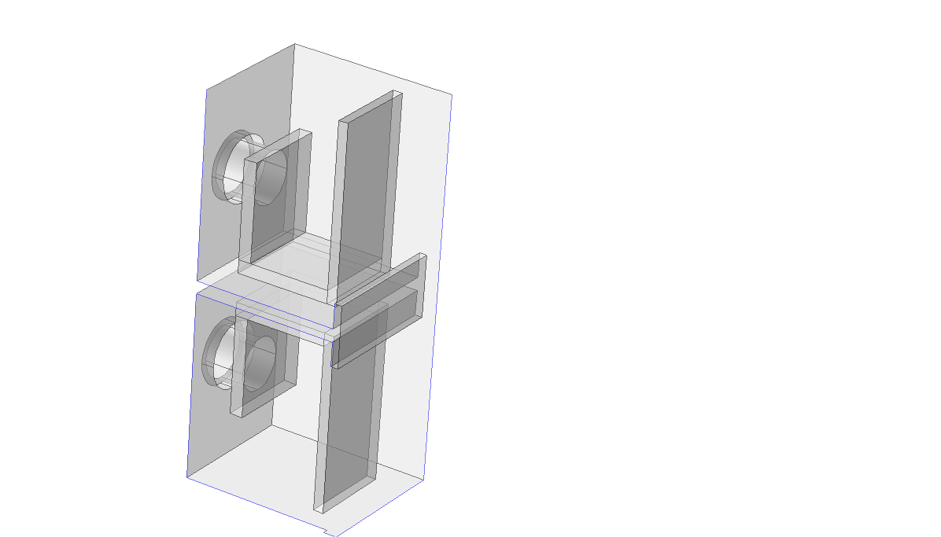
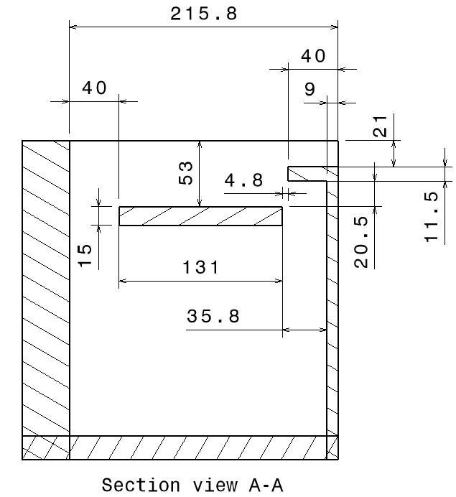
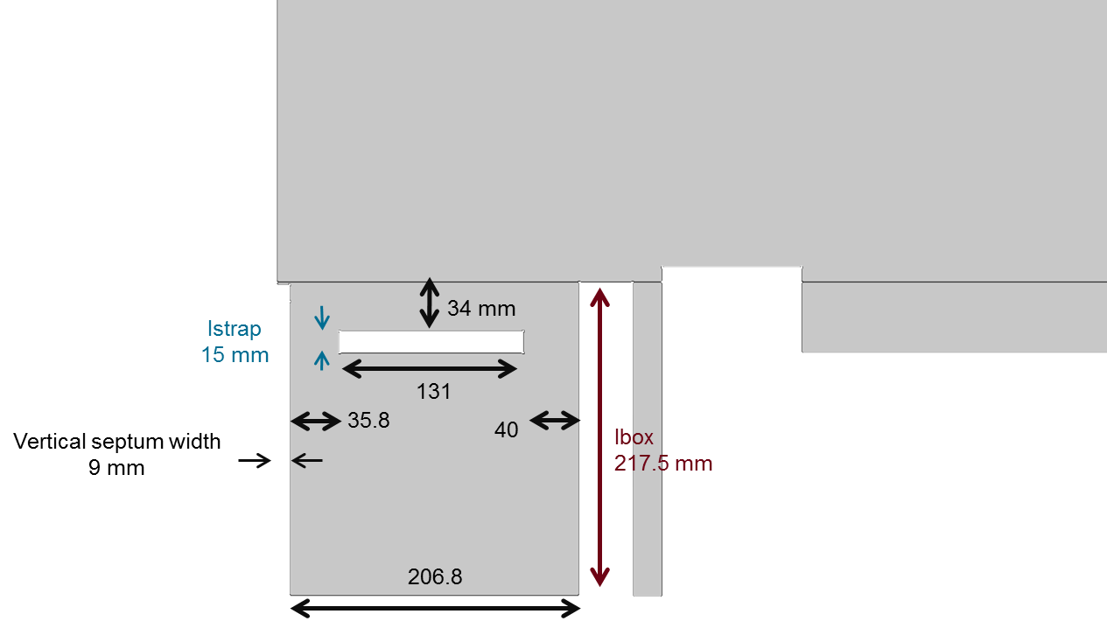
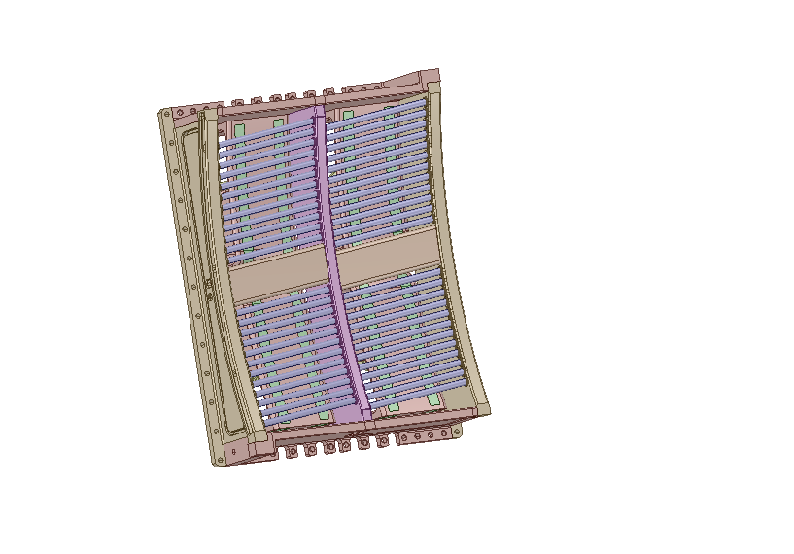
15
Septum 9

Slide 17
Capacitors
Bridge
Impedance Transformer
Straps+
R=20000000
"plasma"
R=0.01
L=2.4e-008
V
V
0
R+jX
Name=V2
A
DI=170mm
DI=190mm
net_T
Name=VT
Stage 2
Stage 1
Feeder 30Ohm
RZ=1.08meter
C=69.3186156951009pF
Name=I2
DO=214mm
DO=214mm
IZ=30ohm
R=20000000
ER=1
ER=1
A
R=0.01
V
P=30mm
P=20mm
Name=IT
DI=2*235mm
DI=Stage2_Dint
DI=Stage2_Dint
DI=Stage1_Dint
DI=140mm
L=2.4e-008
DO=2*246mm
DO=2*246mm
DO=Stage2_Dout
DO=Stage1_Dout
DO=230mm
Name=V3
A
ER=1
ER=1
ER=1
ER=1
ER=1
PNUM=1
0
R+jX
P=L3
P=d1
P=L2
P=L1
P=200mm
RZ=30ohm
RZ=1.08meter
C=81.9301249915538pF
Name=I3
DI=170mm
DI=190mm
IZ=0ohm
IZ=30ohm
DO=214mm
DO=214mm
ER=1
ER=1
P=30mm
P=20mm
Service Stub
DI=56mm
DO=150mm
ER=1
0
P=1350mm

Slide 18
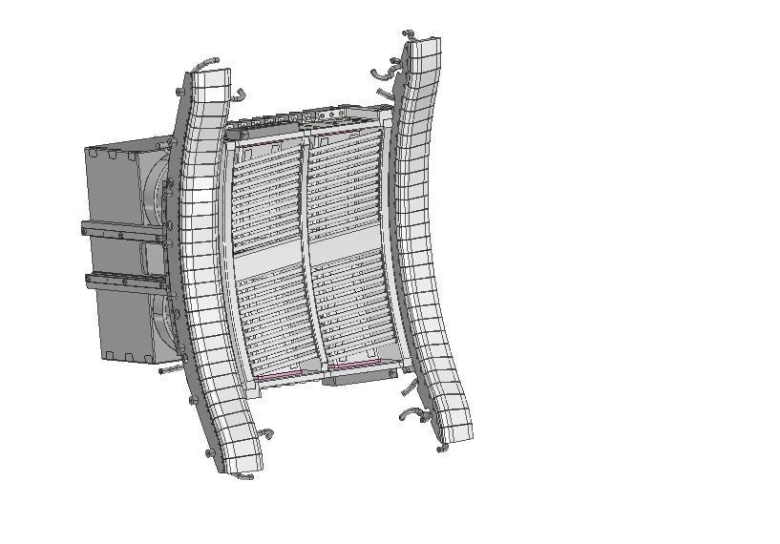
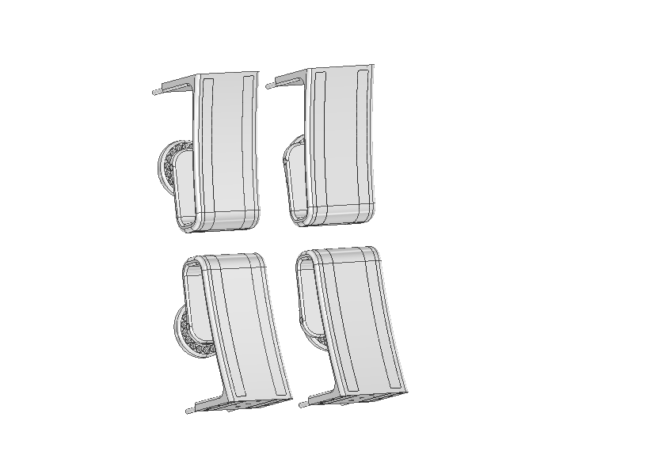
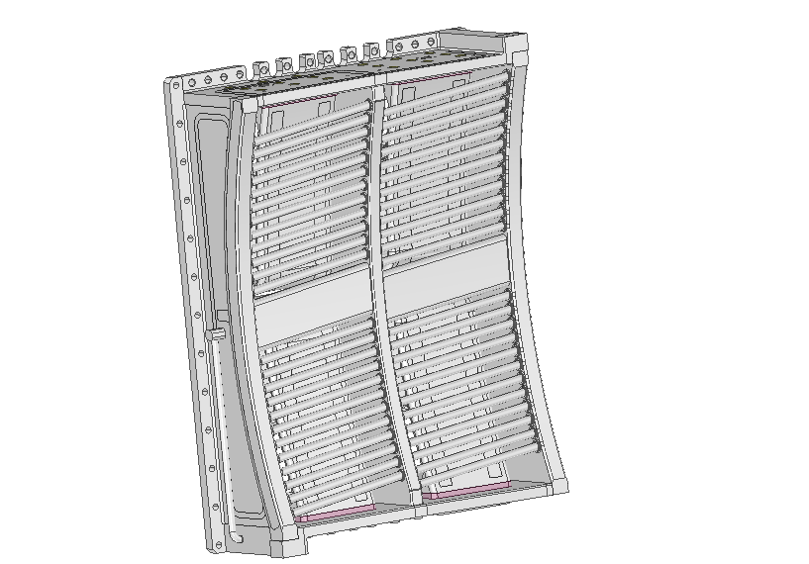
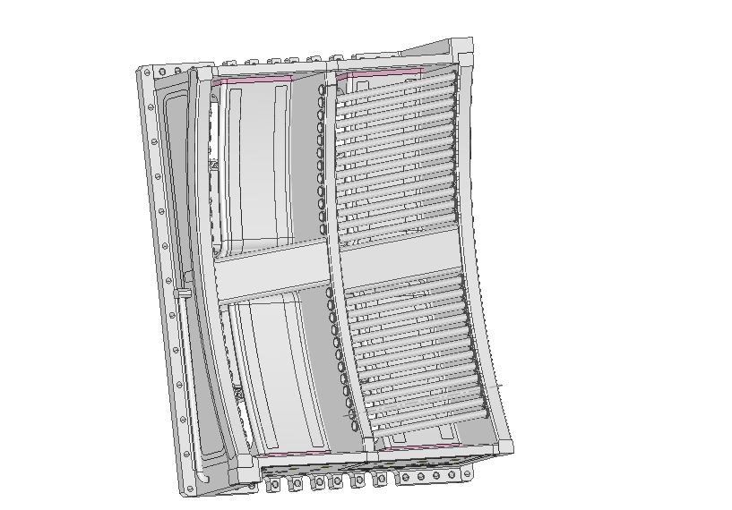

Slide 19
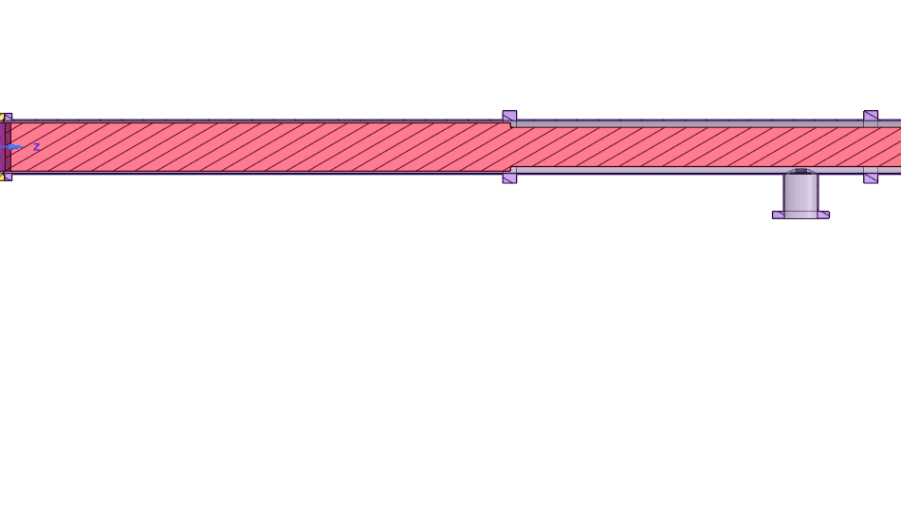
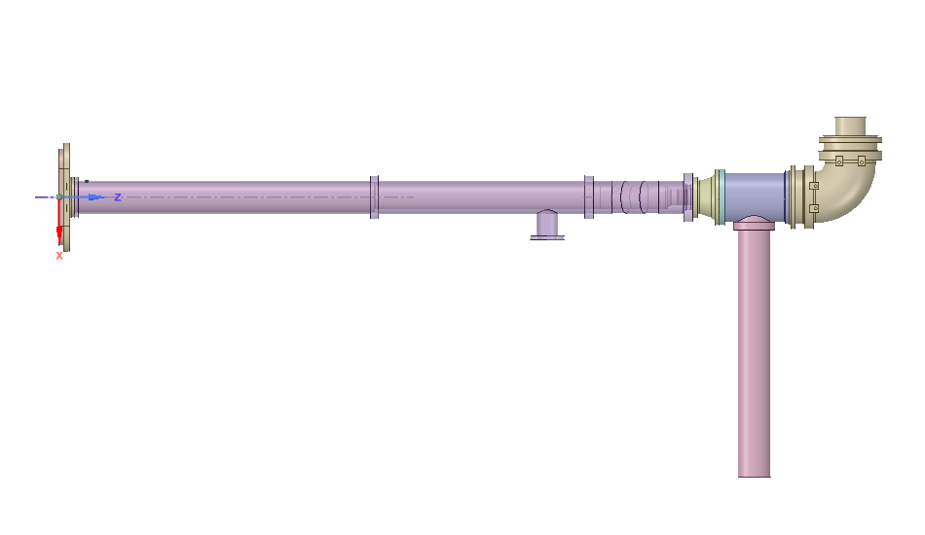
Toward
Generator
(30 Ω line)
Toward
Antenna
Front-face
153
140
153
114
Feedthrough
Service-stub
(inner conductor
water cooling)
5.3 Ω Section
17.6 Ω Section

Slide 20
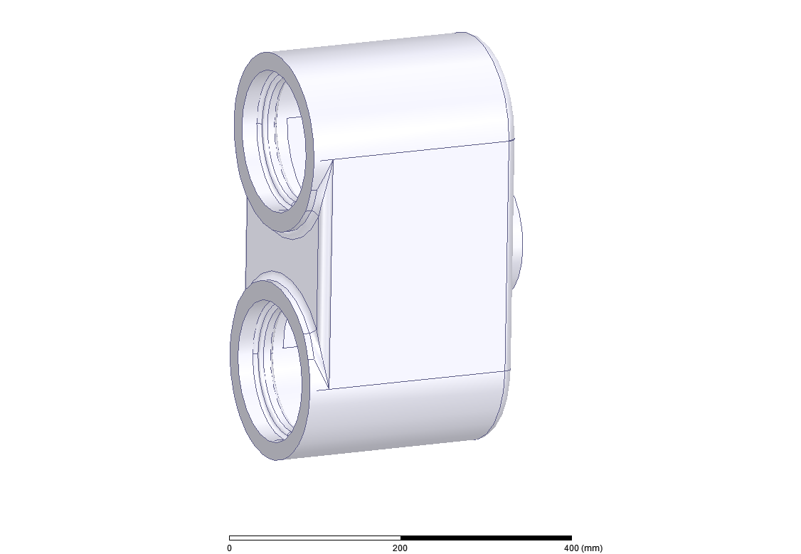

Slide 21
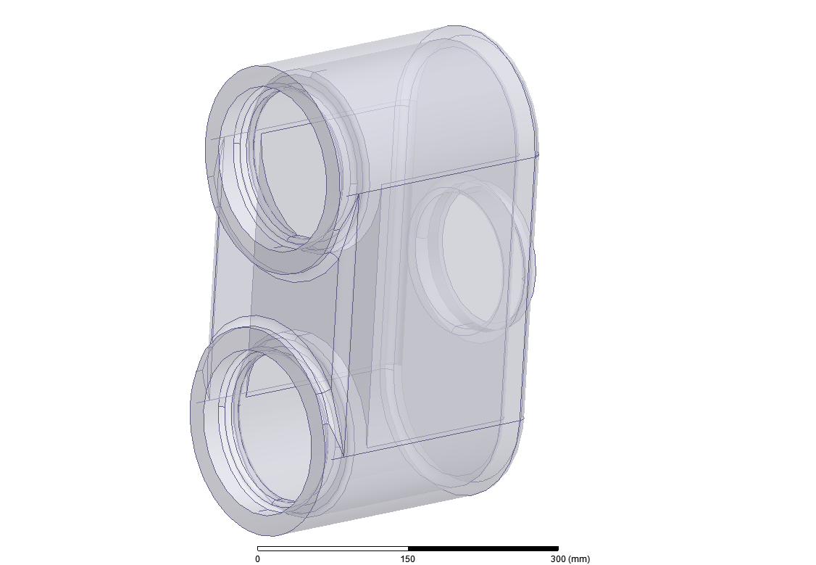

Slide 22
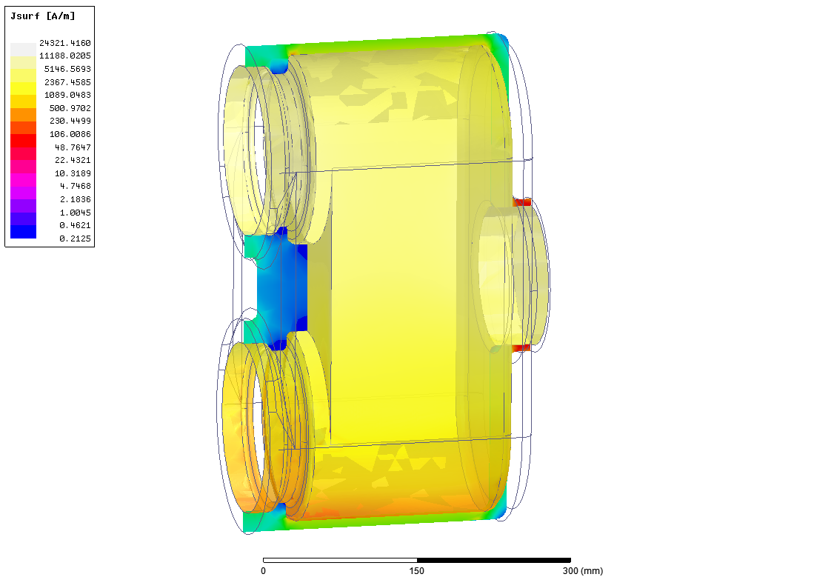

Slide 23
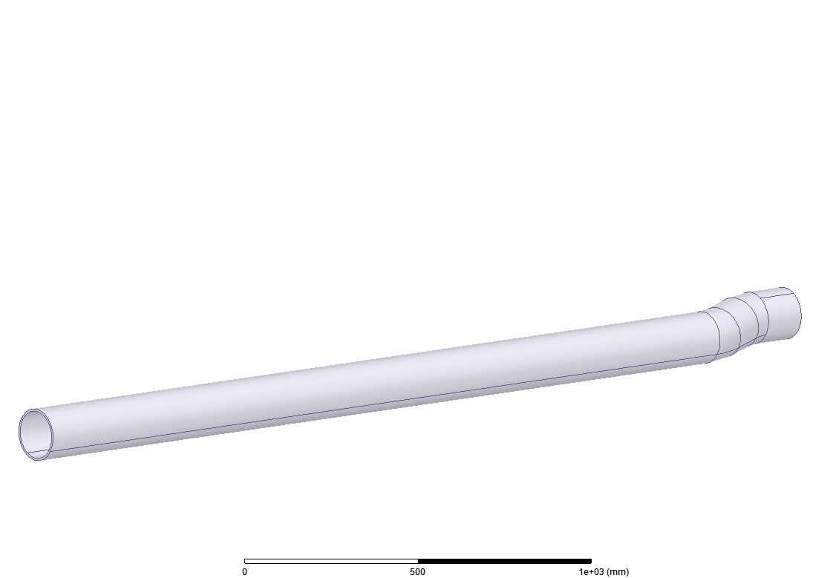

Slide 24
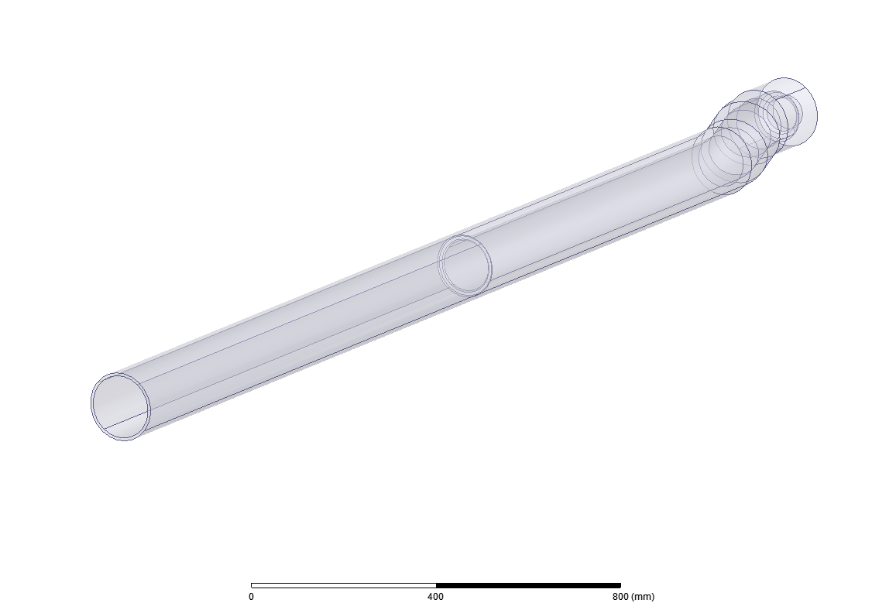

Slide 25
